Slide 1

WIPRO NGA Program – 25SUB4508_LSP
Capstone Project Presentation – 13th Feb & 14th Feb 2026
Project Title Here - Distributed Content Discovery & Inspection Utility (DCDIU) Implementation
Presented by -
www.rpsconsulting.in

Slide 2

Distributed Content Discovery & Inspection Utility (DCDIU) Implementation
Introduction :
Managing large volumes of files and directories manually across systems is time-consuming and error-prone. Identifying specific content within distributed storage environments can be difficult and inefficient without automation.
The Distributed Content Discovery & Inspection Utility (DCDIU) allows users to recursively traverse directories, search for specific keywords within files, and inspect file contents efficiently from a centralized interface.
It uses a C++ POSIX-based backend with a modular client-server architecture to provide reliable directory scanning, deep content analysis, structured logging, and robust error handling across Unix-like systems.
2026 - RPS Consulting all rights reserved

Slide 3

Distributed Content Discovery & Inspection Utility (DCDIU) Implementation
Problem Statement :
In modern computing environments, organizations and system administrators face several challenges, such as:
-- Difficulty in locating specific files within deeply nested directory structures.
-- Time-consuming manual inspection of large volumes of files to find relevant content.
-- Inefficient keyword searching across distributed or decentralized storage systems.
-- Lack of centralized tools to perform recursive directory traversal and deep content analysis.
-- Limited visibility into file contents without opening each file individually.
-- A robust, automated utility is essential to ensure efficient, accurate, and scalable content discovery across systems.
2026 - RPS Consulting all rights reserved

Slide 4
Distributed Content Discovery & Inspection Utility (DCDIU) Implementation
Objective :
➔ Primary Objectives
-- Develop a secure command-line utility for recursive directory traversal and content discovery.
-- Enable searching and inspection of files using keyword-based deep scanning.
-- Provide a centralized system to manage file discovery and inspection efficiently.
➔ Secondary Objectives
-- Ensure portability across Unix-like and POSIX-compliant systems.
-- Maintain structured logging for monitoring and debugging.
-- Support multi-client handling using a modular client-server architecture.
2026 - RPS Consulting all rights reserved

Slide 5
Distributed Content Discovery & Inspection Utility (DCDIU) Implementation
Key Features:
🔹 Client–Server Architecture
Clear separation between request initiation (client) and processing (server).
🔹 Remote Directory Traversal
Recursive traversal of directories from a configurable base path.
🔹 Deep Content Discovery
Scans file contents for specific strings or patterns across all traversed files.
🔹 File Inspection Mode
Allows targeted inspection and retrieval of file content using absolute paths.
🔹 Structured Response Handling
Server sends processed results back to the client in a readable format.
🔹 Robust Error Handling & Logging
Centralized exception handling and logging for reliability.
2026 - RPS Consulting all rights reserved

Slide 6
Distributed Content Discovery & Inspection Utility (DCDIU) Implementation
Client –Server Communication Feature:
Description:
This feature enables communication between the client and the server using TCP sockets. It forms the foundation of all other system features.
Functional Requirements:
The server shall listen for incoming client connections.
The server shall prompt the client for authentication credentials (username and password).
The client shall provide valid login credentials to the server.
The server shall authenticate the client using secure hashed password verification.
Only authenticated clients shall be allowed to execute commands.
The client shall send text-based commands to the server after successful authentication.
2026 - RPS Consulting all rights reserved

Slide 7
Distributed Content Discovery & Inspection Utility (DCDIU) Implementation
The server shall process commands and send responses back to the client.
The connection shall remain active until the client issues an exit command..
The connection shall remain active until the client issues an exit command.
Inputs
Client command strings (e.g., TRAVERSE, SEARCH, INSPECT, EXIT)
Processing
Socket creation and connection establishment
Command transmission and reception
Request parsing on the server side
2026 - RPS Consulting all rights reserved

Slide 8
Distributed Content Discovery & Inspection Utility (DCDIU) Implementation
Requirement Tag | Requirement Description
Functional Requirements
DCDIU_FR_01 | The utility shall be capable of performing recursive directory traversals on a remote target server, with an optional configurable base path.
DCDIU_FR_02 | DCDIU must support deep-content discovery by scanning for specific strings, phrases, or patterns across all files in the target directory and returning a comprehensive match list.
DCDIU_FR_03 | The system shall allow for targeted retrieval of specific files when an absolute path is provided, enabling the user to view the raw data stream.
DCDIU_FR_04 | The utility must provide a 'Content Inspection' mode, allowing users to select and display the full data contents of any file identified during the discovery phase.
DCDIU_FR_05 | The framework shall implement an exception handling module to display descriptive system messages when traversal or discovery operations fail.
DCDIU_FR_06 | A command-line driven interface (CLI) shall be provided, featuring a structured menu for all supported discovery and inspection operations.
DCDIU_FR_07 | The system must integrate a diagnostic logging engine with four standardized severity levels: FATAL, INFO, WARNING, and DEBUG.
2026 - RPS Consulting all rights reserved

Slide 9
Distributed Content Discovery & Inspection Utility (DCDIU) Implementation
Non-Functional Requirements | Requirement Description
DCDIU_NF_01 | Portability: The utility shall be compatible with all standard Unix-like and POSIX-compliant Operating Systems.
DCDIU_NF_02 | Modularity: The system architecture shall utilize well-defined interfaces to ensure scalability and the addition of future data-parsing modules.
2026 - RPS Consulting all rights reserved

Slide 10
Distributed Content Discovery & Inspection Utility (DCDIU) Implementation
Functional Requirements Mapping:
Requirement ID | Description | Implementation Module
DCDIU_FR_01 | Client–Server Connection | TCP Socket
DCDIU_FR_02 | Recursive Directory Traversal | DirectoryTraverser
DCDIU_FR_03 | Deep Content Scanning | ContentScanner
DCDIU_FR_04 | File Inspection by Absolute Path | FileInspector
DCDIU_FR_05 | Request Parsing & Delegation | ClientHandler / Server
DCDIU_FR_06 | Structured Response Delivery | Server → Client Communication
DCDIU_FR_07 | Error Handling | ExceptionHandler
DCDIU_FR_08 | Logging & Observability | Logger
2026 - RPS Consulting all rights reserved

Slide 11
Distributed Content Discovery & Inspection Utility (DCDIU) Implementation
Function Module :
1. Directory Traversal Module:
-- Recursive scanning of directories and subdirectories
-- Collect and manage file paths dynamically
2. Content Scanning Module:
-- Search for specific keywords within files
-- Perform deep content discovery across all scanned files
3. File Inspection Module:
-- Display full file content on request
-- Enable detailed inspection of selected files
4. Logging & Exception Module:
-- Maintain structured logs (INFO, WARNING, DEBUG, FATAL)
-- Handle system errors gracefully using ExceptionHandler
5. Multi-Client Handling Module:
-- Handle multiple client connections concurrently
-- Manage independent client requests using threading
6. Communication Module:
-- Establish client-server socket connection
-- Exchange directory path and keyword data securely
7. System Monitoring Module:
-- Maintain detailed activity logs for auditing
-- Monitor execution status and error reporting
2026 - RPS Consulting all rights reserved

Slide 12
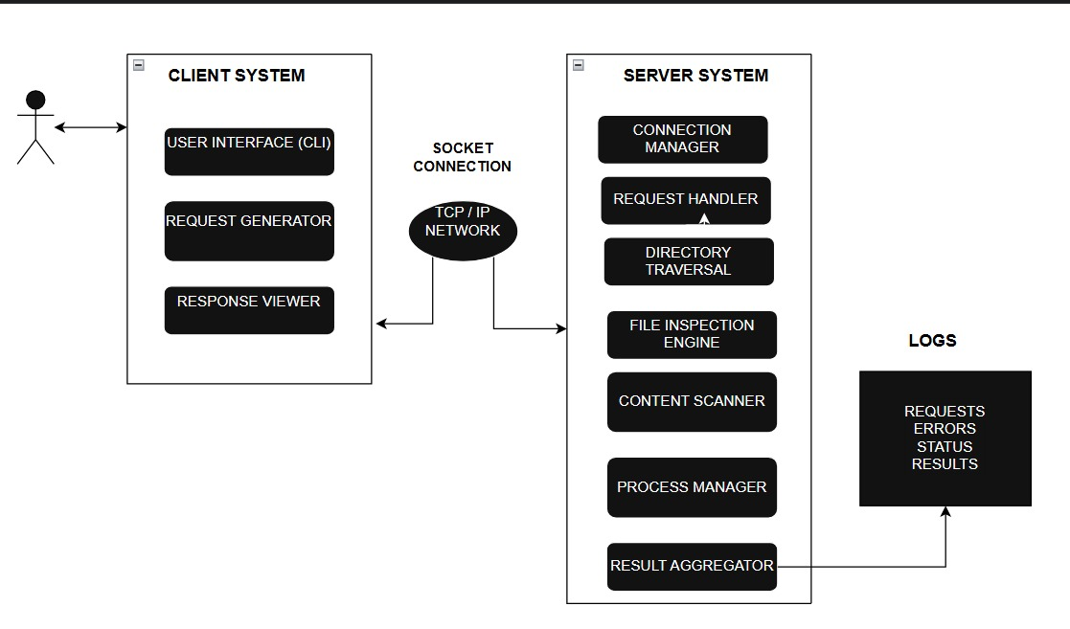
Distributed Content Discovery & Inspection Utility (DCDIU) Implementation
System Architecture:
2026 - RPS Consulting all rights reserved

Slide 13
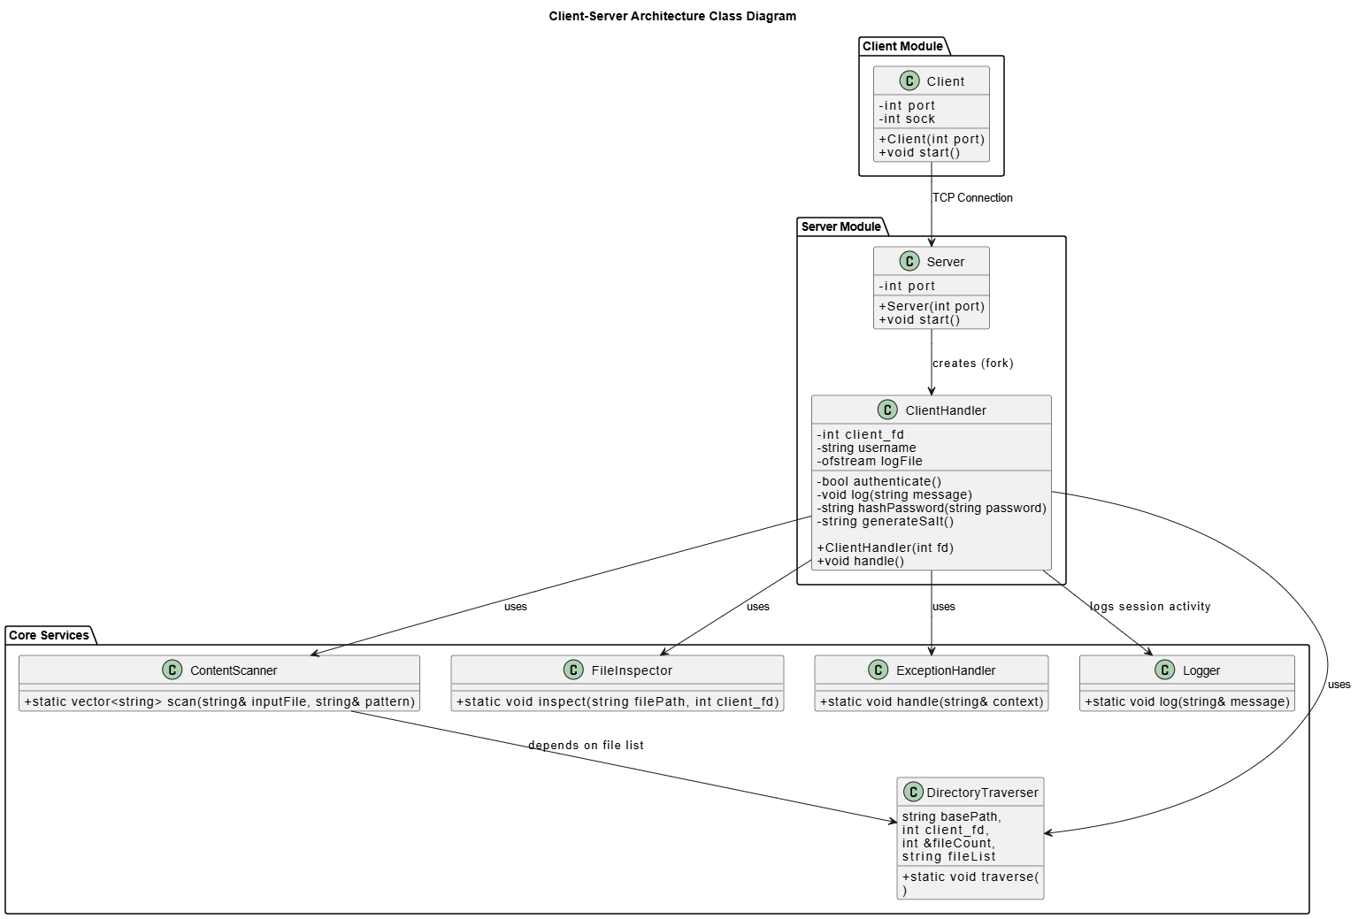
Distributed Content Discovery & Inspection Utility (DCDIU) Implementation
System Architecture:
Class Diagram
2026 - RPS Consulting all rights reserved

Slide 14
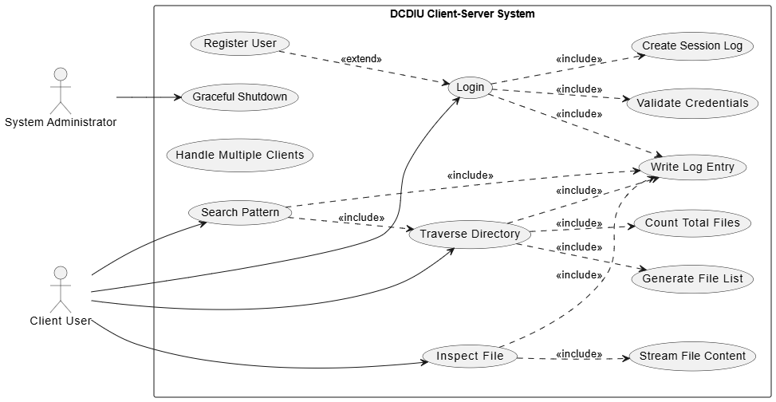
Distributed Content Discovery & Inspection Utility (DCDIU) Implementation
Use-Case Diagram:
2026 - RPS Consulting all rights reserved

Slide 15
Distributed Content Discovery & Inspection Utility (DCDIU) Implementation
Build Instructions
1.1 Prerequisites
- Linux / WSL / macOS
- g++ (C++17 compatible)
- make
- OpenSSL Development Library
Install OpenSSL:
bash
sudo apt update
sudo apt install libssl-dev
1.2 Build
From the project root directory:
bash
make clean
make
This generates:
- build/server
- build/client
2026 - RPS Consulting all rights reserved

Slide 16
Distributed Content Discovery & Inspection Utility (DCDIU) Implementation
Running the Application
1.1 Start the Server
Open Terminal 1:
bash
./build/server
The server starts listening on the configured port.
1.2 Start Clients
Open Terminal 2 / Terminal 3:
bash
./build/client
Multiple clients can connect simultaneously.
2026 - RPS Consulting all rights reserved

Slide 17
Distributed Content Discovery & Inspection Utility (DCDIU) Implementation
How to Use the Application
This section describes the actual execution flow and output of the DCDIU system as observed during testing.
1.1 Starting the Client
Run the client application using:
bash
./build/client
On successful connection, the client prompts for registration or login.
Example:
Username: Mershika
Password: (Enter Your password)
Account created
This confirms that the authentication module is working correctly.
2026 - RPS Consulting all rights reserved

Slide 18
Distributed Content Discovery & Inspection Utility (DCDIU) Implementation
1.2 Main Menu
After login, the client displays the main menu
----------------------
Display Menu
----------------------
1. Traverse
2. Search
3. Inspect
4. Exit
Users can select an option by entering the corresponding number.
2026 - RPS Consulting all rights reserved

Slide 19
Distributed Content Discovery & Inspection Utility (DCDIU) Implementation
1.3 Directory Traversal (Option 1)
When the user selects option 1 (Traverse), the system requests a directory path.
Example:
Choice: 1
Enter directory path: /home/student/25SUB4508
The server performs recursive traversal and sends the results to the client.
Sample Output:
Directory: /home/student/25SUB4508
Directory: /home/student/25SUB4508/25sub4508_56117
Directory: /home/student/25SUB4508/25sub4508_56117/Capstone
File: /home/student/.../Custom_system_call_using_Dockerfile_1_.pdf
File: /home/student/.../CA_SOFTWARE.pptx
This confirms successful directory scanning and file detection.
2026 - RPS Consulting all rights reserved

Slide 20
Distributed Content Discovery & Inspection Utility (DCDIU) Implementation
1.4 Search (Option 2)
Allows users to search for specific files or keywords within the selected directory.
Steps:
1. Select option 2
2. Enter search keyword
3. View matched results
1.5 Inspect (Option 3)
The Inspect feature analyzes selected files and displays detailed information such as size, type, and content patterns.
Steps:
1. Select option 3
2. Provide file or directory path
3. Review inspection report
2026 - RPS Consulting all rights reserved

Slide 21
Distributed Content Discovery & Inspection Utility (DCDIU) Implementation
1.6 Exit (Option 4)
Safely terminates the client session and disconnects from the server.
Client Commands
Command Description
/exit Exit the client application
Logging & Observability
Log files are stored in:
-logs/username_pid.log
2026 - RPS Consulting all rights reserved

Slide 22
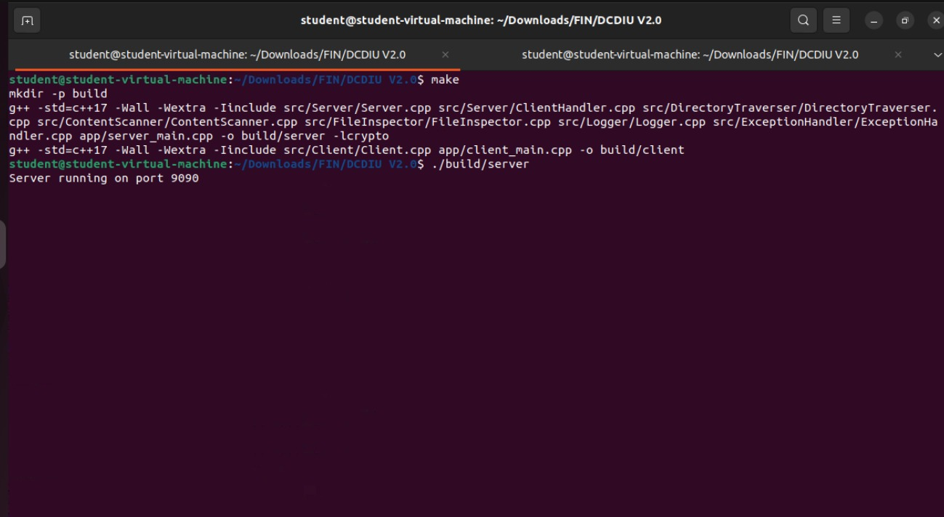
Distributed Content Discovery & Inspection Utility (DCDIU) Implementation
Output: Connecting to the server
2026 - RPS Consulting all rights reserved

Slide 23
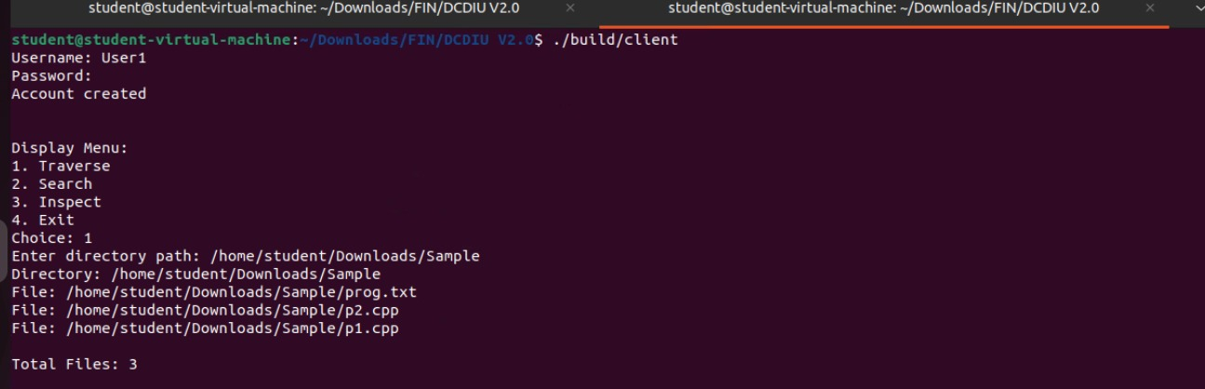
Distributed Content Discovery & Inspection Utility (DCDIU) Implementation
Output: Choice 1)Traverse
2026 - RPS Consulting all rights reserved

Slide 24
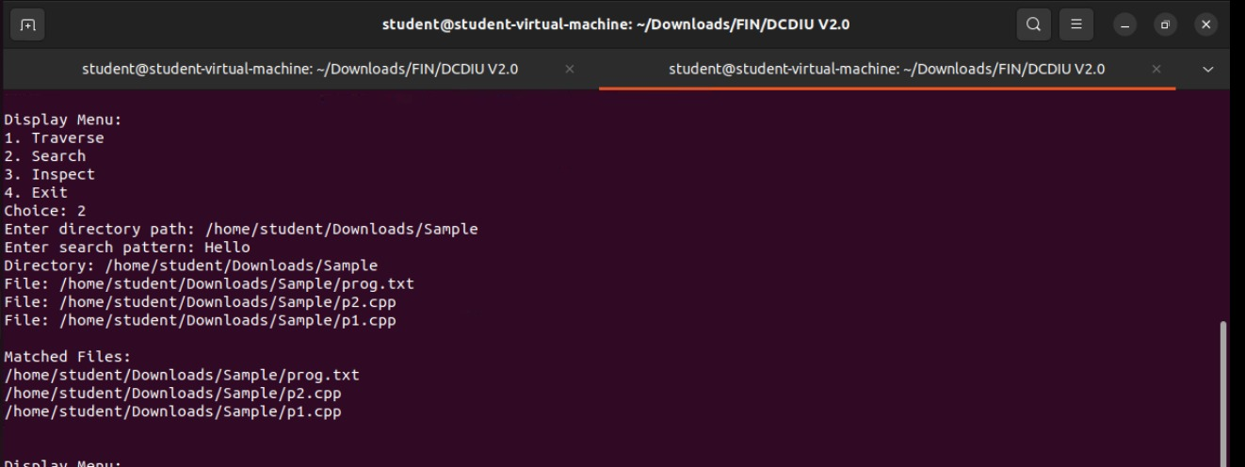
Distributed Content Discovery & Inspection Utility (DCDIU) Implementation
Output: Choice 2) Search
2026 - RPS Consulting all rights reserved

Slide 25
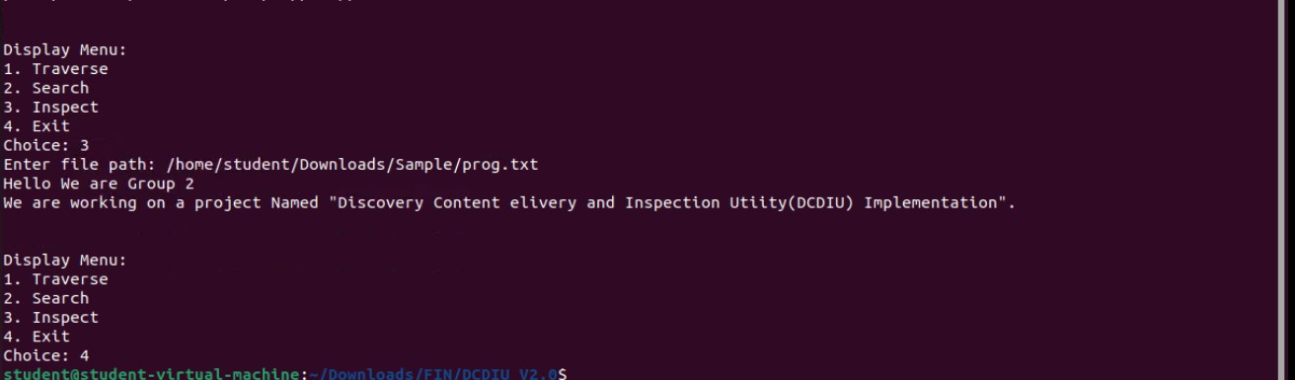
Distributed Content Discovery & Inspection Utility (DCDIU) Implementation
Output: Choice 3) Inspect
2026 - RPS Consulting all rights reserved

Slide 26

2026 - RPS Consulting all rights reserved

